Slide 1
Software Myths
Software Myths are common misconceptions or misunderstandings about software development processes, costs, time, and effort.
These myths often stem from a lack of knowledge or outdated views about software engineering.
Believing in these myths can lead to unrealistic expectations, poor project planning, or failures in software projects.

Slide 2
Software Myths
Myth: “Once the program is written, the job is done.”
Reality: Software evolves over time; maintenance is crucial.
Myth: “Adding more people speeds up the project.”
Reality: Brook's Law – more people can increase complexity.
Myth: “The client knows exactly what they want.”
Reality: Requirements often change; iterative feedback is vital.
Myth: “Software quality can be tested in at the end.”
Reality: Quality must be ensured throughout the lifecycle.

Slide 3
Software Myths (Contd.)
5. “More features = better software.”
Reality: Adding unnecessary features can make software more complicated, harder to maintain, and less user-friendly. The focus should be on delivering the right features, not just more features.
6. “Project management and documentation are unnecessary overheads.”
Reality: Good project management and clear documentation ensure that the project stays on track and is maintainable, especially in larger teams or long-term projects.
7. “Developers can anticipate all user needs.”
Reality: Without involving end users, developers may miss important usability issues. Regular feedback and user involvement are key to delivering a successful product.

Slide 4
How Software Engineering Overcomes All Myths
Iterative Development: Regular reviews and client feedback ensure adaptability.
Team Management: Agile methodologies, where small teams work in sprints.
Continuous Testing: Integration of testing in every phase ensures higher quality.
Clear Documentation: Focus on gathering requirements and managing changes.
Software Maintenance: Prioritizing post-deployment maintenance.

Slide 5

Software Development Life Cycle (SDLC)
SDLC is a structured process followed for software development. It ensures systematic progress and quality.
Key Models:
Waterfall Model
Agile Model
V-Model
Spiral Model

Slide 6
Phases of SDLC
Requirement Analysis: Gathering business requirements.
System Design: Structuring system architecture and design.
Implementation: Writing the code and translating designs into working software.
Testing: Identifying and fixing bugs to ensure functionality.
Deployment: Releasing the final product to the users.
Maintenance: Ensuring the software operates smoothly post-deployment.

Slide 7
Waterfall Model - Software Development Lifecycle
Introduction to Waterfall Model
Brief definition: A linear and sequential approach to software development.
Suitable for well-understood projects with stable requirements.

Slide 8
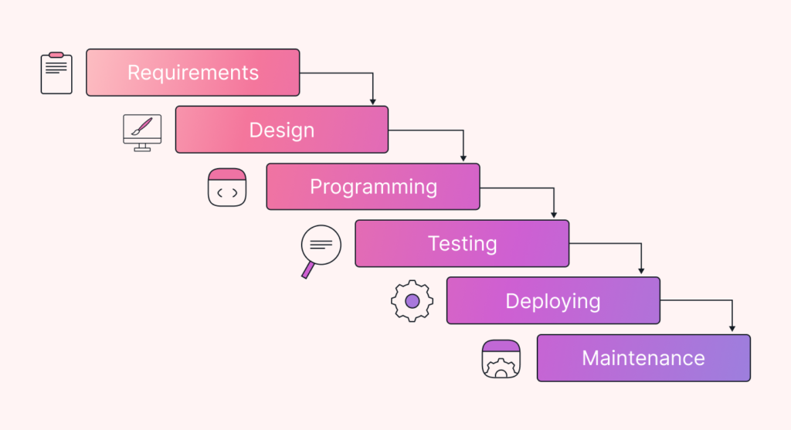

Slide 9
Key Phases of the Waterfall Model
Requirement Gathering & Analysis
Collect all system and software requirements.
Outcome: System Requirements Specification (SRS) document.
System Design
Translate requirements into a design.
Outcome: Design Documents.
Implementation
Development or coding phase based on the design.
Outcome: Working Software Components.
Integration & Testing
Combine components and perform system testing.
Outcome: Verified and Tested Software.
Deployment
Deploy the software into the production environment.
Maintenance
Handle post-deployment issues, enhancements, and fixes.

Slide 10
Advantages
Easy to manage due to a rigid phase-based structure.
Suitable for smaller projects with well-understood requirements.
Clear documentation at every stage.

Slide 11
Disadvantages
Not ideal for projects with changing requirements.
Limited flexibility due to linear structure.
Late testing phase can lead to the discovery of issues at the end.

